Slide 1


2025
AI GPT Model Using Python & OpenAI Fine-Tuning
Some Essential Steps !!
Presented by
Page 1
Next Slide
Chandrika Bijore

Slide 2

2025
What to be
Cover
•Fetch Questions-Answers from MongoDB
• Converting Data to JSONL for Fine-Tuning
• Training a Fine-Tuned Model on OpenAI
• Using the Fine-Tuned Model to Build a GPT Model
• Deploying the Chatbot with Flask API
Page 2
Next Slide

Slide 3

Overview
2025
Fetching Questions-Answers from MongoDB
• MongoDB se data retrieve karne ke liye:
• MongoDB Atlas ya local database ka use karein
• Python me pymongo library ka use karein
• Data ko query karke extract karein
Page 3
Next Slide

Slide 4

2025
Converting Data to JSONL for Fine-Tuning
Fine-tuning ke liye data ko JSONL format me convert karein:
• Har record ek JSON object me ho
• Example: {'messages': [{'role': 'system', 'content': 'Hello'}]}
Page 4
Next Slide

Slide 5

Training a Fine-Tuned Model on OpenAI
2025
Steps for fine-tuning:
Get access to the OpenAI API
Upload JSONL data
Execute the fine-tuning training command
Use the model once it's ready
Page 5
Next Slide

Slide 6

2025
Using the Fine-Tuned Model to Build a GPT Model
Use the fine-tuned model to create a chatbot
Generate responses using the OpenAI API
Design a custom chatbot flow
Page 6
Next Slide

Slide 7

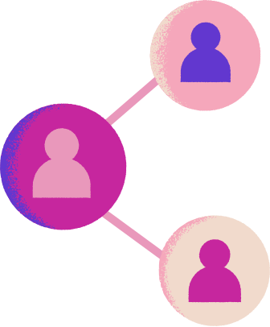

2025
Deployment Through Flask API
Deploy the chatbot using Flask API:
Set up a Flask server
Integrate the model
Define API routes
Use a cloud or local server for deployment
Page 7
Next Slide

Slide 8
2025
Thank
You!
An AI-powered GPT Model built using Python, OpenAI fine-tuning, and MongoDB. This chatbot leverages a custom-trained model on 13,451 Q&A pairs to provide accurate and context-aware responses. Deployed via Flask API for seamless integration.
Page 8
Next Slide

